Slide 1
Ethical Hacking Assignment
Ryan Ng, Ng Ray Son

Slide 2
TABLE OF CONTENTS
Case Scenario & Network Diagram
01
05
Ubuntu Post-Exploits + Pivoting into Windows
Exploiting ZeroLogon
(CVE-2020-1472)
Setup and Configuration
02
06
Reconnaissance
Windows Server Post-Exploits
03
07
Exploiting SambaCry
(CVE-2017-7494)
04
08
References and Additional Troubleshooting

Slide 3
01. Case Scenario & Network Diagram

Slide 4

Case Scenario
Mel is a disgruntled employee of Company13. During COVID-19, the company deployed the Hamachi VPN service to allow employees to work from home, to access the company file shares via the Samba protocol hosted on an Ubuntu File server.
Mel decides to use this opportunity to attack the outdated version of Samba and compromise the server using SambaCry. Since the Samba File Server has an interface communicating with Active Directory Domain, Mel can pivot to and exploit the Domain Controller with the Zerologon vulnerability to steal domain credentials and exfiltrate the company’s data.

Slide 5
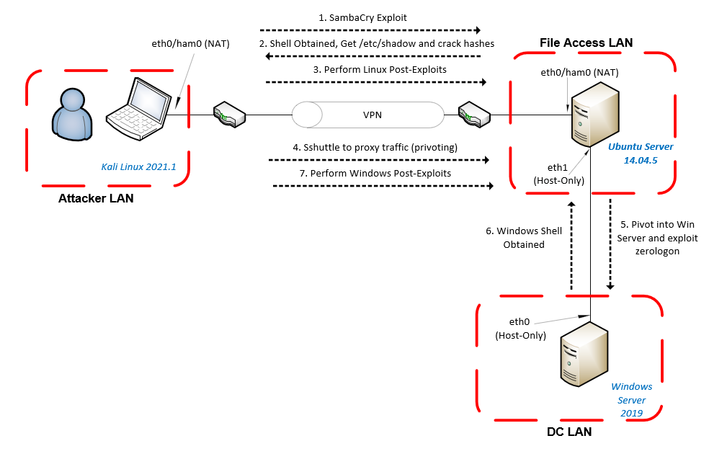

Slide 6
Exploits and Post-Exploitation
Exploit 1: SambaCry
Post Exploit 1: Password Cracking
Post Exploit 2: Clearing Tracks via Log Deletion
Post Exploit 3: Pivoting into Windows Server
Exploit 2: ZeroLogOn
Post Exploit 1: Disabling Windows Firewall
Post Exploit 2: Denying Access to Important Files

Slide 7



02. Environment Setup
+

Slide 8
Devices
Kali Linux 2021.1
(NAT Network Setting)
Ubuntu 14.04.5 Server
(NAT & Host-Only Network Setting)
Windows Server 2019
(Host-Only Network Setting)

Slide 9
Software
Hamachi VPN Service (Kali and Ubuntu)
Samba 4.3.9 (Ubuntu)
OpenSSH-Server (Ubuntu) and Sshuttle (Kali)
Active Directory Installation for Windows Server
Impacket (Kali)
secretsdump.py for extracting hashes on Windows
psexec.py and wmiexec.py privilege escalation scripts

Slide 10
Assumptions in setup
We will make the passwords weak (for both Ubuntu and Windows Server) so that they can be easily cracked in a short period of time for the purpose of demonstration. In the real world, these should be long and random.
Windows Server (COMPANY13\Administrator : Pa$$w0rd)
Ubuntu Samba Server (smbvictim : smbvictim)
The Ubuntu Machine is preconfigured with SMB protocol version 1, because in the real world, without forcing the server to use SMBv1, the server will probably use a later (or the latest version)

Slide 11
Reasons for using Hamachi
Provides some form of security.
Virtual machines communicate with each other directly (don’t need port forwarding and prevents accidental intrusion into other devices)
Free to set up VPN networks of up to 5 devices
suits our needs as we have only a few VMs for testing
Actual Simulation of Remote Work
VPN is often used for remote administration of company devices

Slide 12
Kali & Ubuntu Server Setup

Slide 13
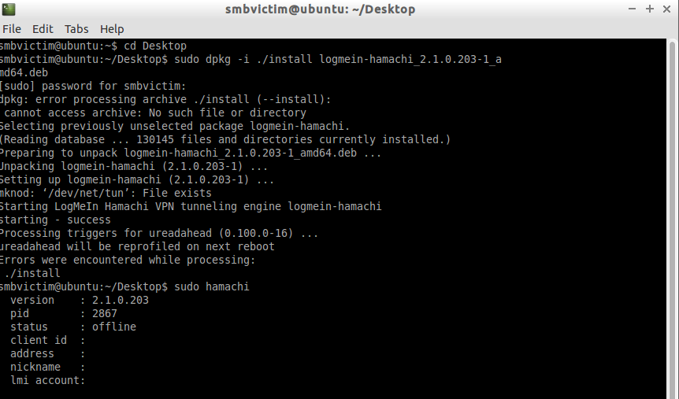
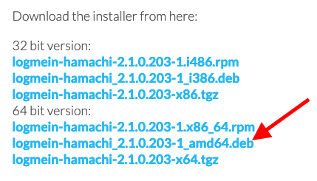
Hamachi VPN Setup (Kali and Ubuntu 14.04)
We can download the hamachi debian package on the website and use dpkg to install it.
https://www.vpn.net/linux
It is advised to download the 64-bit deb package when working on kali 2021.1.

Slide 14
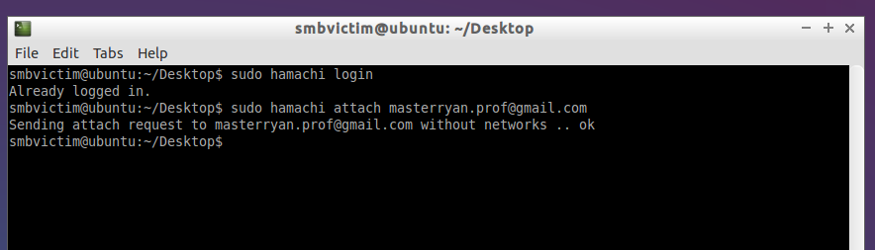
Adding hosts to the hamachi network
$ sudo hamachi login
$ sudo hamachi attach <email>
To start using hamachi after installation, we have to first login, then we have to join a network created by someone with a valid email address.

Slide 15
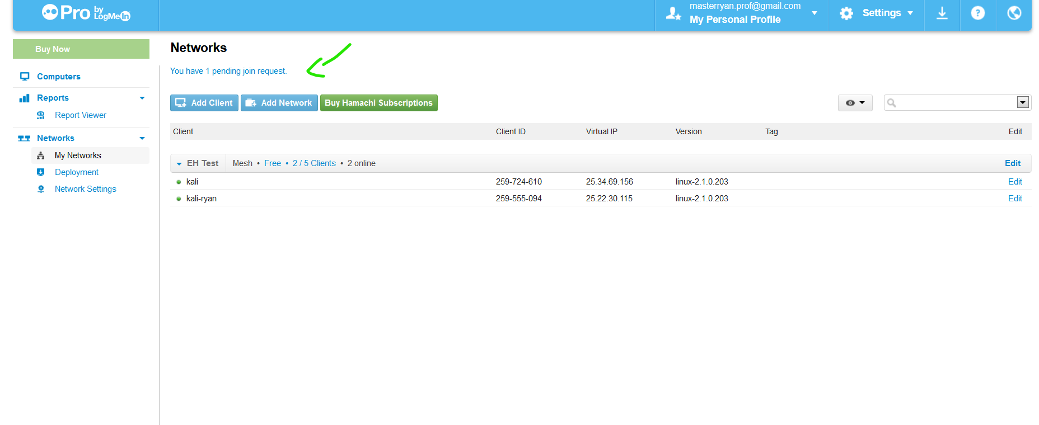
Adding hosts to the hamachi network
Dashboard Link: https://secure.logmein.com/central/Central.aspx
If you have an existing account and ran the 2 commands before, there will be a notification in the “My Network tab“ on regarding the pending join request.

Slide 16
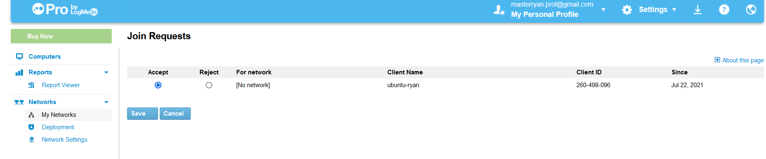
Adding hosts to the hamachi network
We can either accept or reject this request by clicking on it and hitting “Save”.

Slide 17
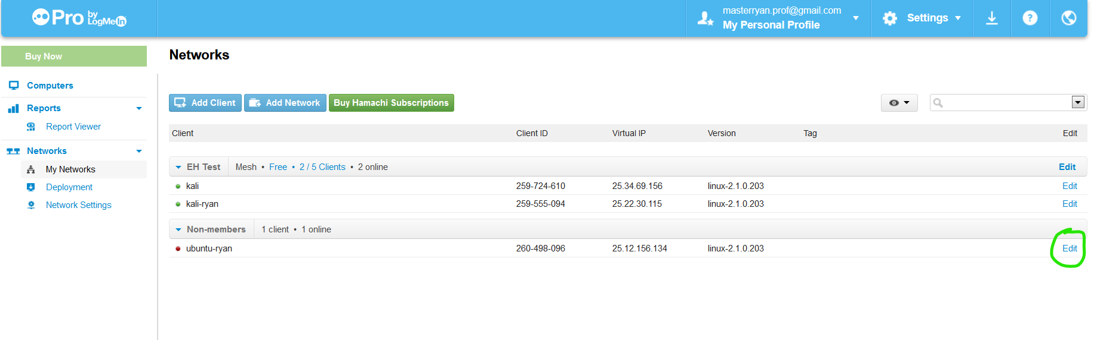
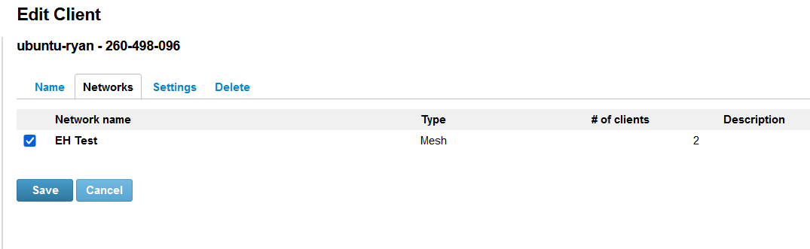
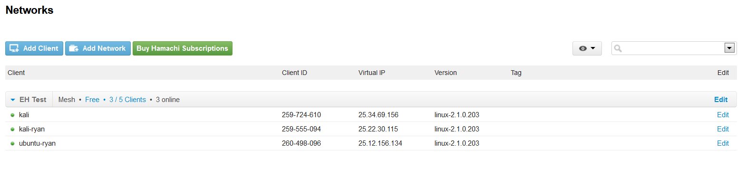
Adding hosts to the hamachi network
We can then proceed to create a new network and if we have already done so, we can use the “Networks” tab to select the network we wish to add the client to.
Thereafter, returning to the main dashboard, there should be a list of all the clients in the network (green besides the name indicates online and red is offline)

Slide 18
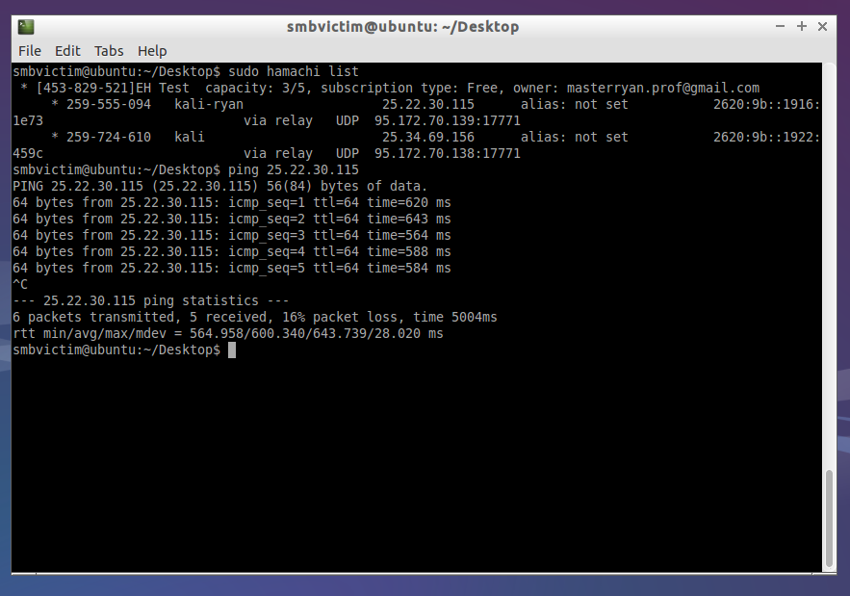
Testing connectivity to the hamachi network
We can test connectivity to the other machines on the network by pinging them, or get a list using the command below:
$ sudo hamachi list

Slide 19
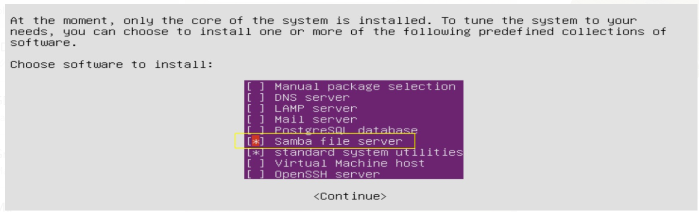
Installing Samba on Ubuntu 14.04
* Samba must be installed during the setup of the Ubuntu virtual machine.
If it is manually installed using apt after setup, the Samba version will not be vulnerable to the SambaCry attack., since apt likely has a more up-to-date debian free software guidelines (dfsg) version .

Slide 20
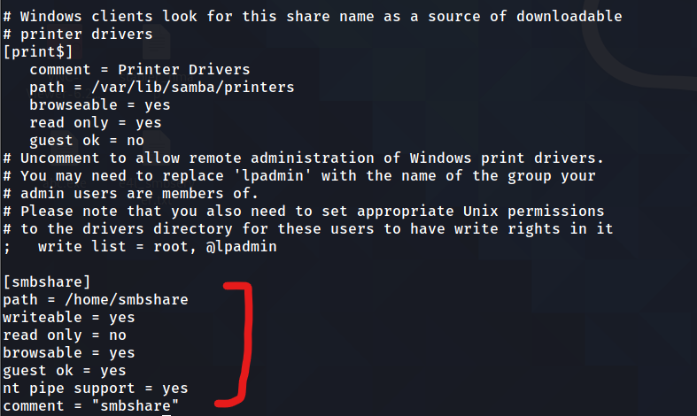
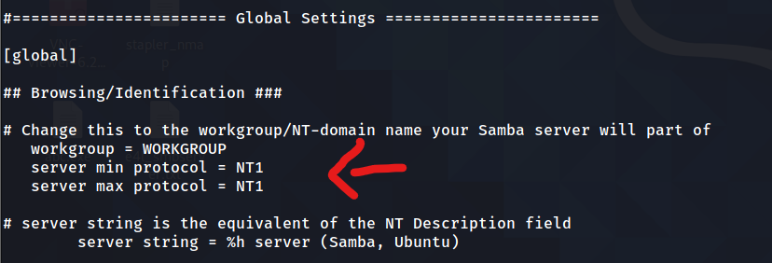
Configuring Samba on Ubuntu 14.04
Adding server min and max protocol to NT1 limits the SMB service to use v1 of the protocol, which is vulnerable to SambaCry. Later versions are not vulnerable. A similar configuration should also be done for the client (kali linux attacker machine)
*see footnotes for configuration details
As for the basic configuration of the samba share at the end of the file, we will include that it is browsable, can be written to and various other properties like comments.
Notes:
[on ubuntu]
server min protocol = NT1
server max protocol = NT1
[on ubuntu]
server min protocol = NT1
server max protocol = NT1

Slide 21
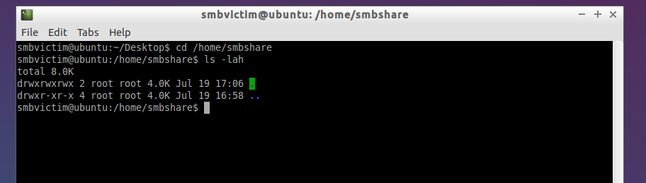
Creating the Samba Share
We can make the share using the following commands (mine had already been created):
$ mkdir /home/smbshare
$ chmod 777 /home/smbshare # to allow the exploit to be run

Slide 22
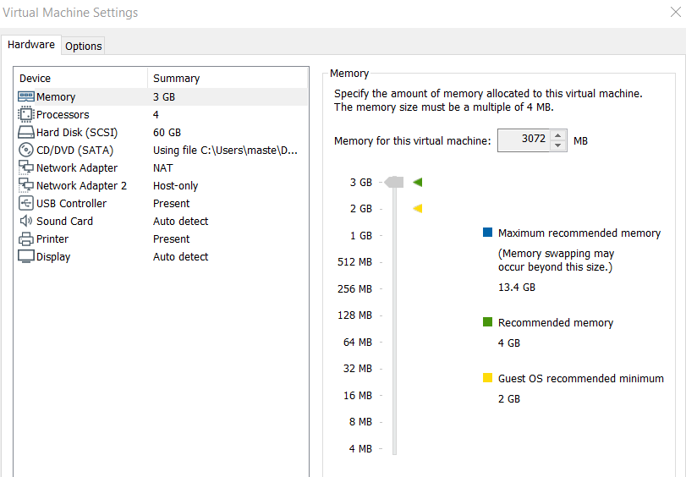
Configuring the 2 Network Interfaces on Ubuntu
Add a new network interface to the Ubuntu machine, configuring it as host-only. This will allow us to perform the pivoting attack later on and make the ubuntu server the “proxy”.

Slide 23
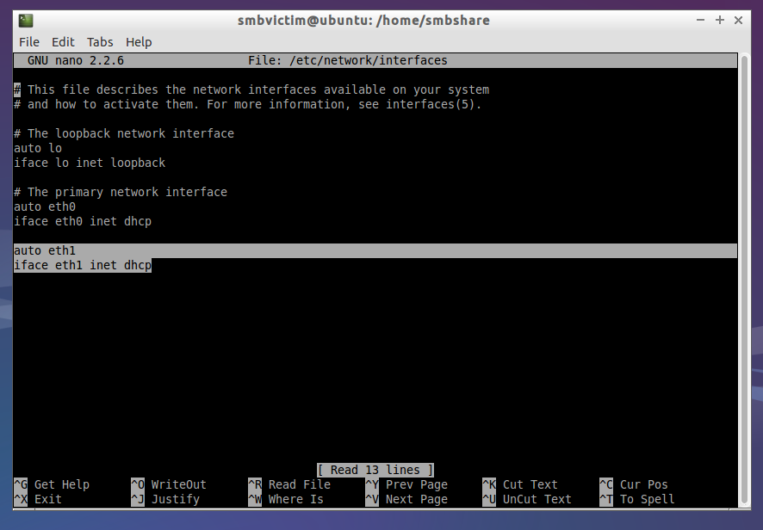
Configuring the 2 Network Interfaces on Ubuntu
As we will need 2 network interfaces on the Ubuntu Machine, we will need to configure them to allow for network connectivity (the machine defaults to use the new interfaces that we have added), which will be made host-only.
Add the 2 lines highlighted to allow connectivity and test it by “ping google.com” (to ensure dns is working correctly)

Slide 24
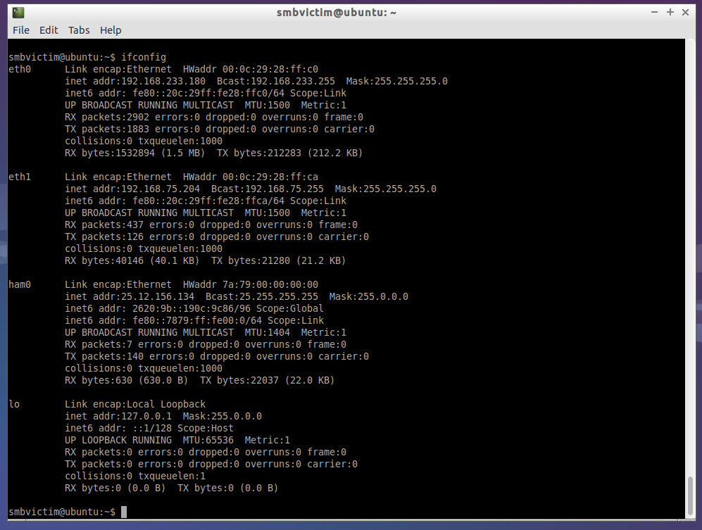
Final Network Configuration Screenshot (Ubuntu)
This is how the interface configuration should look like after finishing the set-up on the Ubuntu Server
eth0 (NAT interface for connectivity to the VPN)
eth1 (Internal Interface for communicating with the Windows Domain Controller)
ham0 (hamachi VPN custom interface)
lo (loopback interface)

Slide 25
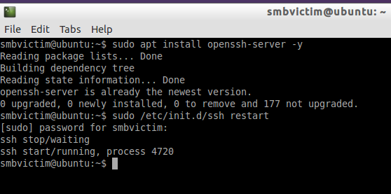
Installing ssh and sshuttle for pivoting
Installation and Configuration
Commands (on Ubuntu):
$ sudo apt-get install openssh-server
$ sudo /etc/init.d/ssh restart

Slide 26
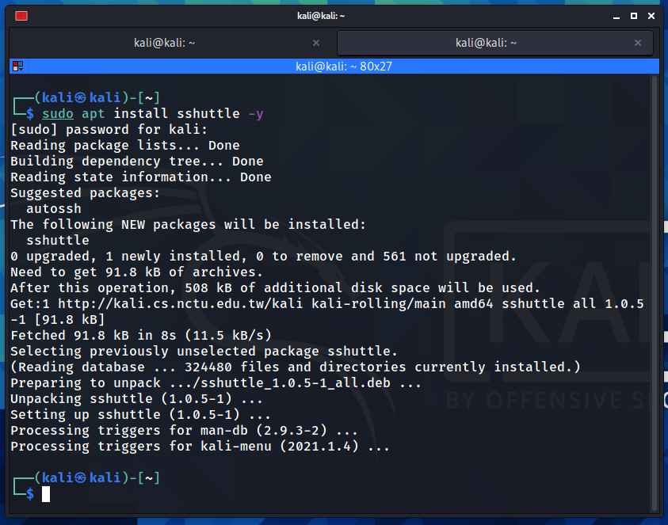
Installing ssh and sshuttle for pivoting
Sshuttle
Installation Commands (Kali):
$ sudo apt install sshuttle
Sshuttle is used for pivoting from our session in the Ubuntu machine into our remote Windows Server via a SSH connection. This allows our Kali Linux to communicate with the Windows Server despite being in different IP subnets.

Slide 27
Kali Linux Setup
Impacket
Installation Commands:
$ git clone https://github.com/SecureAuthCorp/impacket.git
$ cd impacket
$ python3 -m pip install .
$ sudo pip install virtualenv
$ virtualenv --python=python3 impacket
$ source impacket/bin/activate
$ pip install --upgrade pip
$ pip install .
Impacket will be used in our second exploit, the Zerologon exploit. Two python files found in Impacket are required for the exploit: Secretsdump.py and Psexec.py.
Secretsdump.py: This is used to retrieve the password hashes of devices in the domain after exploiting the Zerologon attack and setting the administrator’s password to an empty string.
Psexec.py: This is used to create a command shell session in the Windows server using the Administrator’s password hash.

Slide 28
Windows Server Setup

Slide 29
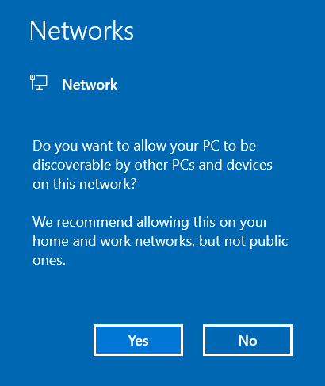
Windows Server 2019 Miscellaneous Config
If this screen appears, click “yes” since we want to conduct a pivoting attack later on.

Slide 30
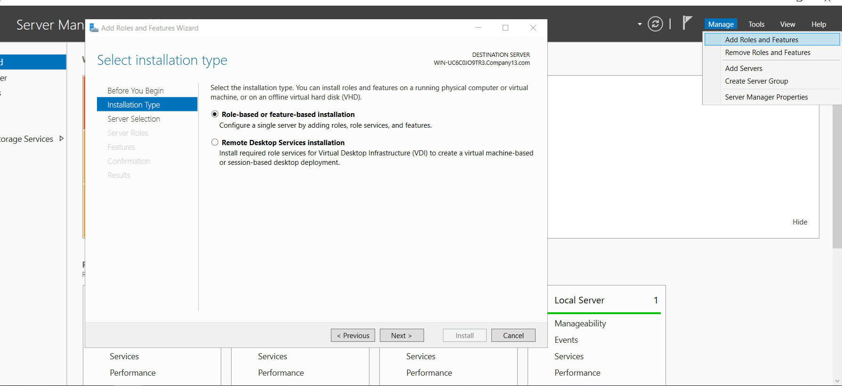
Installing Active Directory for Windows Server 2019
Select Add Roles and Features and go though the installation with defaults

Slide 31
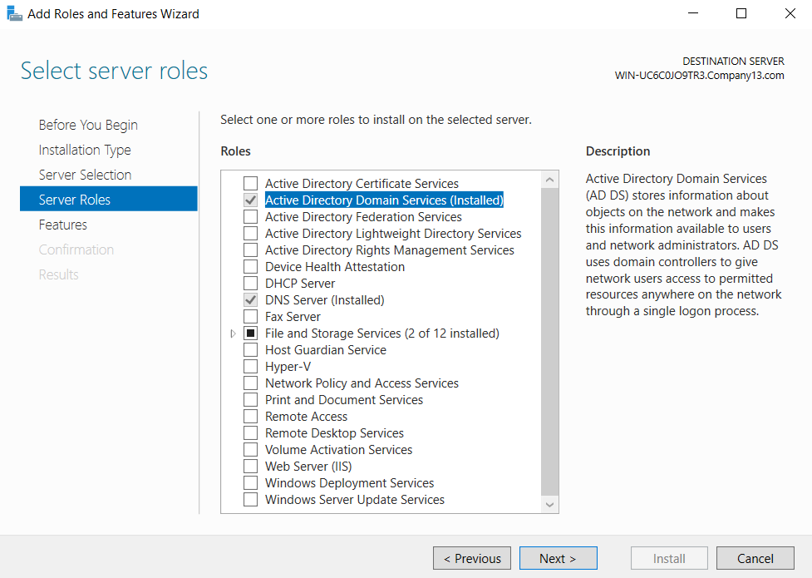
Installing Active Directory for Windows Server 2019
Upon reaching this page, select Active Directory Domain Services and proceed to install with the other defaults.

Slide 32
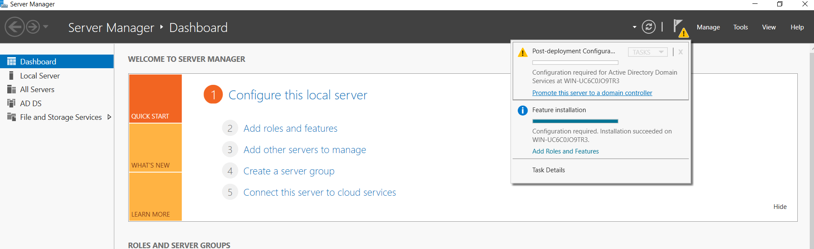
Installing Active Directory for Windows Server 2019
Once installation is complete, we can then prompt the server to a domain controller by clicking on the relevant buttons

Slide 33
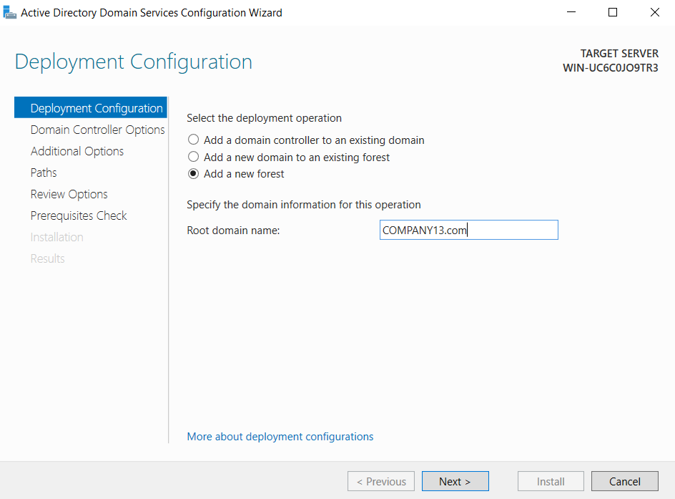
Installing Active Directory for Windows Server 2019
Give the domain a name (e.g. smthg.com)

Slide 34
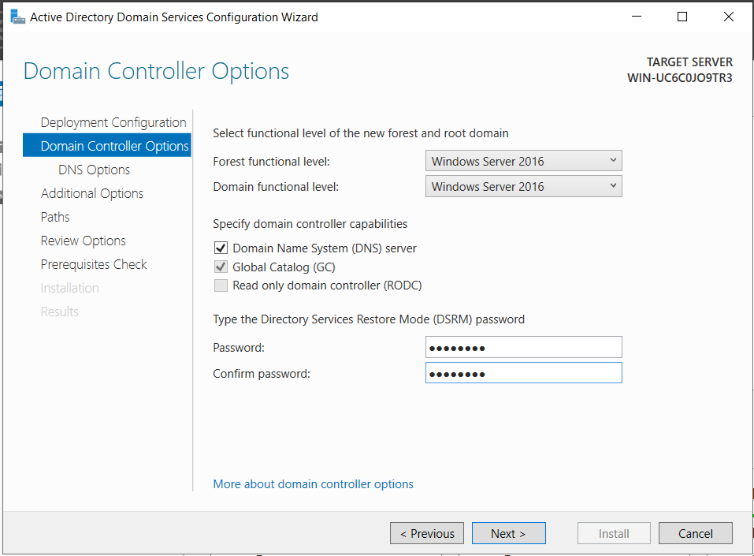
Installing Active Directory for Windows Server 2019
Configure a password for managing accounts on the domain. In this case we will just give a simple password.

Slide 35
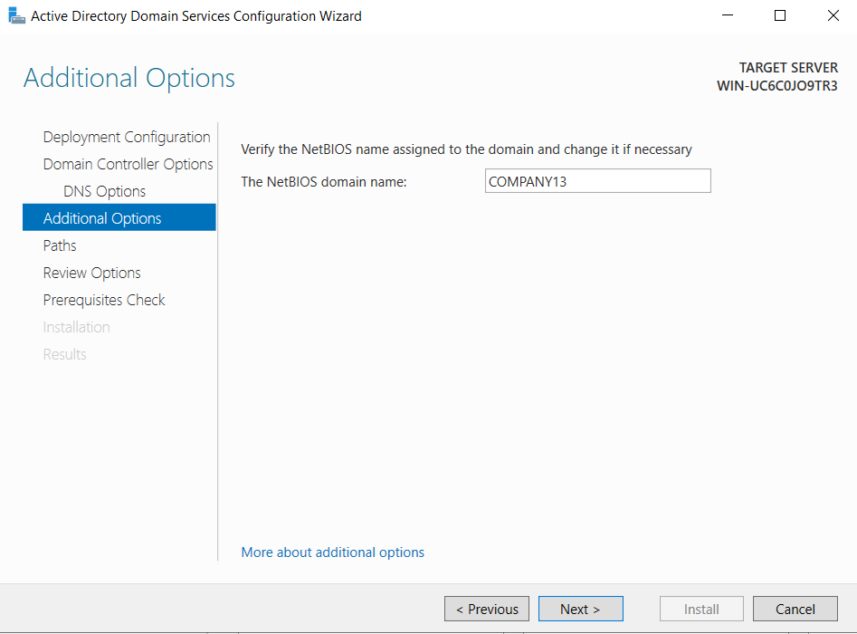
Installing Active Directory for Windows Server 2019
Check the NetBIOS domain name and proceed with the default options to promote the server to a Domain Controller.

Slide 36
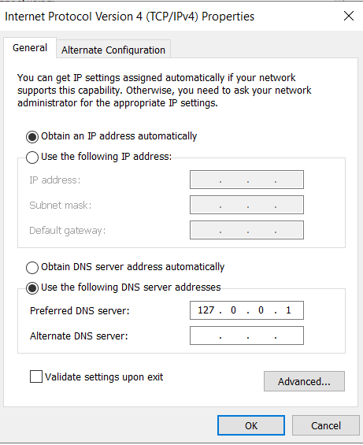
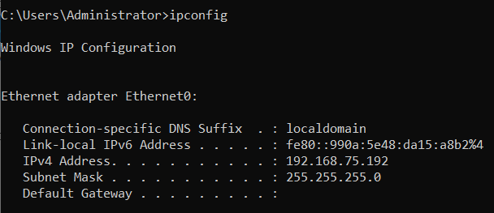
Network Configuration for Windows Server
This it the network configuration for the host-only ethernet interface on the Server after the DC is installed.
Ensure DHCP is used and the preferred DNS server is configured to the loopback interface.

Slide 37

03. Reconnaissance

Slide 38
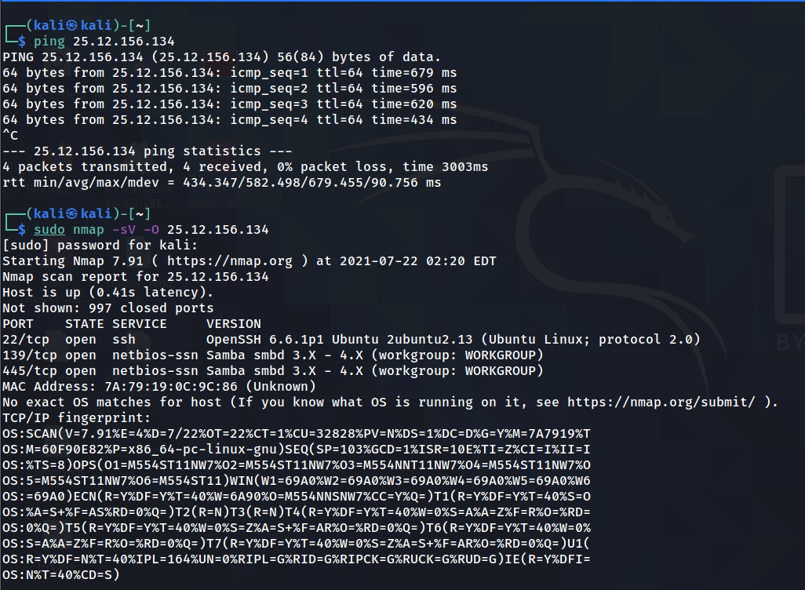
Enumerating Services on Ubuntu
After connecting to hamachi, we should ensure that kali is able to ping the Ubuntu machine before proceeding with reconnaissance. We will first scan the ubuntu machine for open ports.
Based on our scan, ssh and SMB ports are open.

Slide 39
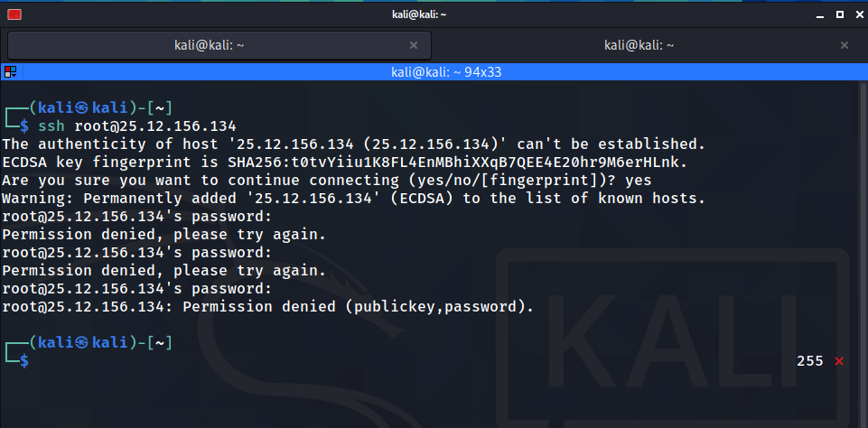
Enumerating Services on Ubuntu
To simulate an attack, we will attempt what the attacker normally does -- to try to login to ssh but these attempts are blocked.

Slide 40
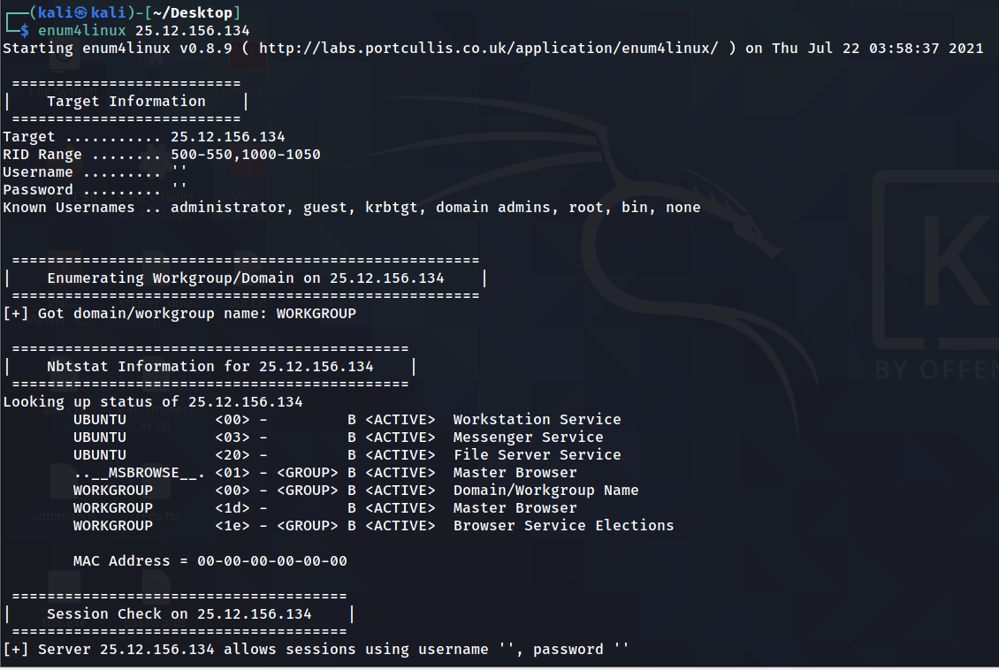
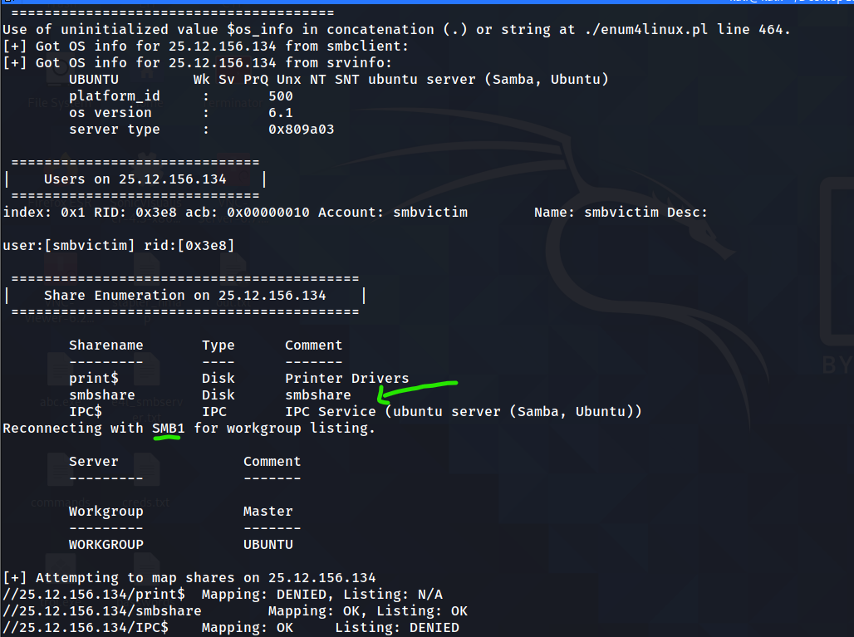
Enumerating Services on Ubuntu
Similarly, we can also enumerate SMB share on the linux machine using enum4linux and the results show that it is most likely vulnerable since SMBv1 is used.

Slide 41
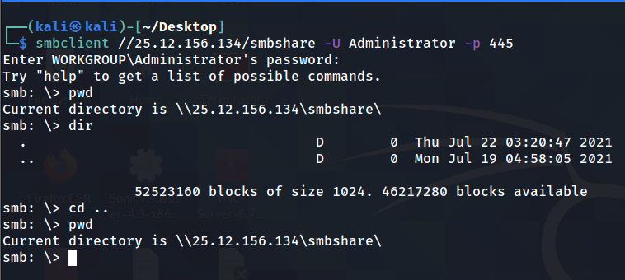
Enumerating Services on Ubuntu
We can try to login to the SMB share using Administrator and Anonymous since these are the 2 accounts commonly used for login (check if password is blank or bruteforce). We are able to login (due to the configuration file in the ubuntu machine) but cannot compromise the machine by this method (restricted only to the share folder at /home/smbshare). As shown above directory traversal does not work.

Slide 42
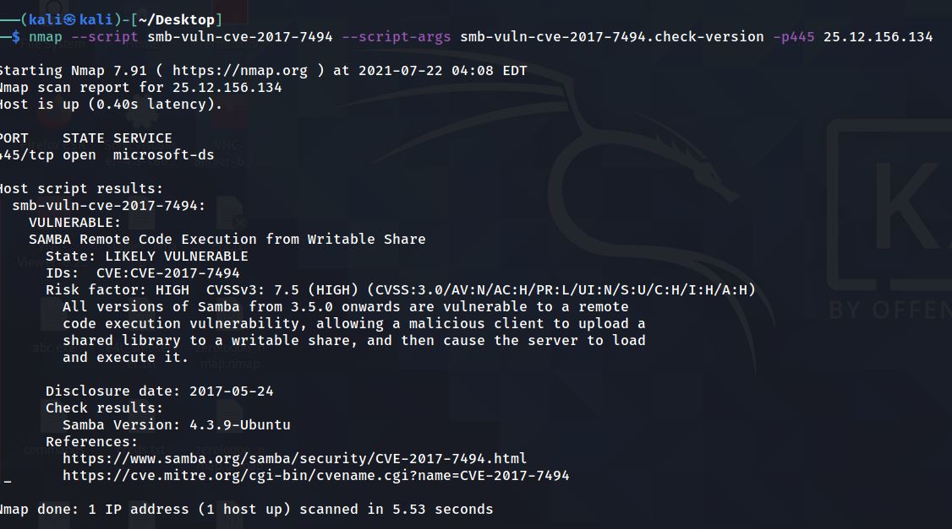
Enumerating Services on Ubuntu
We can then try to scan the machine with a NSE script to check if it is vulnerable to the SambaCry Vulnerability. The results shows it likely is so we can try to exploit it!
Notes:
Link: https://nmap.org/nsedoc/scripts/smb-vuln-cve-2017-7494.html

Slide 43
04. Exploiting SambaCry
Part 1.1: SambaCry (CVE-2017-7494)

Slide 44
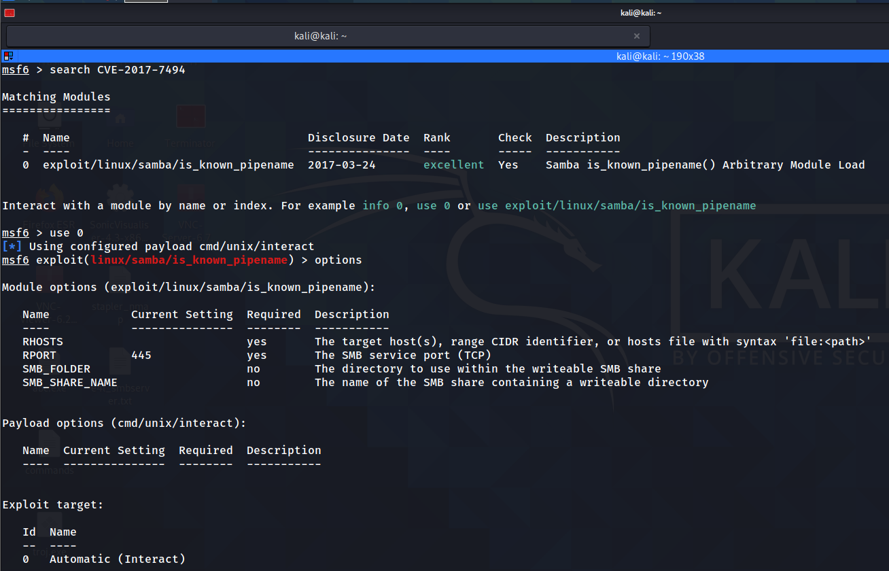
SambaCry Exploit
search CVE-2017-7494
use 0
options

Slide 45
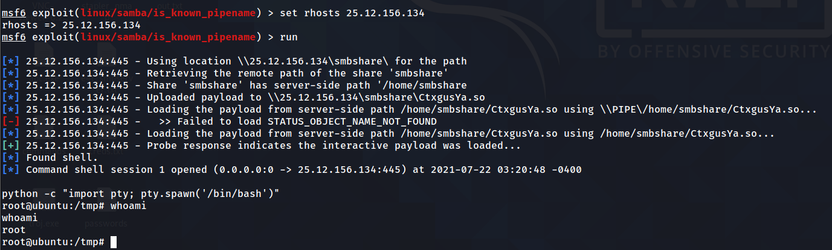
SambaCry Exploit
set rhosts 25.12.156.134 (ham0 on ubuntu)
run
python -c “import pty; pty.spawn(‘/bin/bash’)”
Notes:
python -c "import pty; pty.spawn('/bin/bash')"

Slide 46

05.1 Ubuntu Post-Exploits

Slide 47
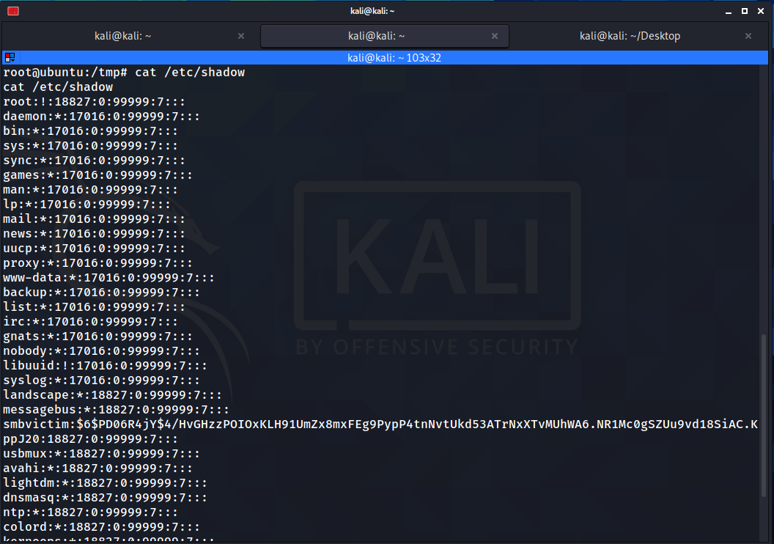
Obtaining the password hash
$ cat /etc/shadow
This command outputs a list of hashes of users on the linux system. Often these users are system processes. The more interesting ones usually have a long hash string, which contain the type of hash, the salt used and the hash itself followed by some miscellaneous information denoted with colons.

Slide 48
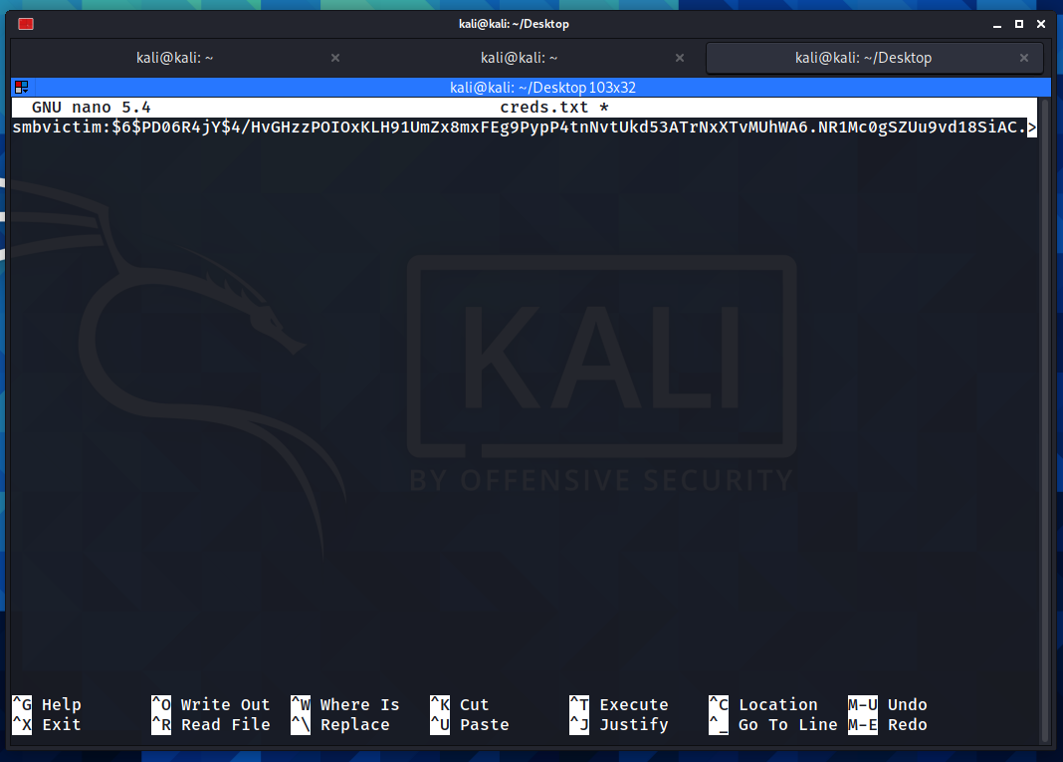
Preparing to crack the passwords
Create a new text file using the following commands:
cd ~/Desktop && touch creds.txt
sudo nano creds.txt

Slide 49
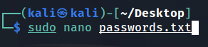
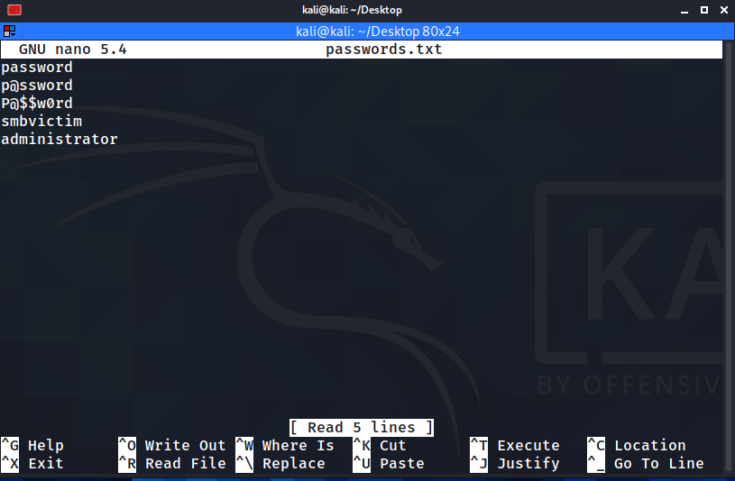
Preparing to crack the passwords
Create a new text file containing a wordlist of passwords using the following command:
sudo nano passwords.txt
Note that for this exercise, we have a password of “smbvictim” and a short password list for simplicity sake. In a real corporate environment, root accounts passwords for Samba servers should be long, unique and complex.

Slide 50
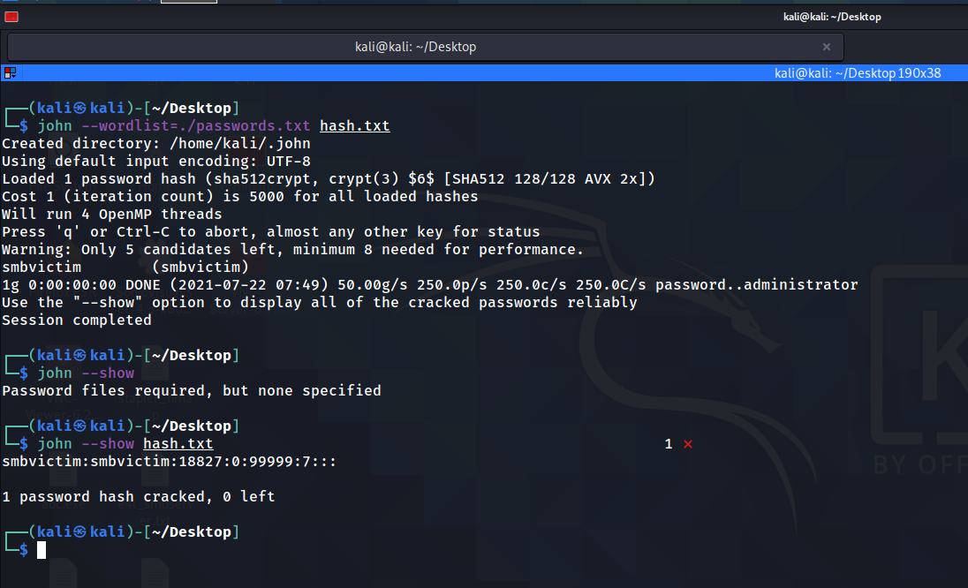
Cracking the passwords
We can use john to crack the password and even specify a wordlist
$ john --wordlist=./passwords.txt hash.txt
$ john --show hash.txt
We can now use the gained credentials to attempt proxy-forwarding using sshuttle.

Slide 51
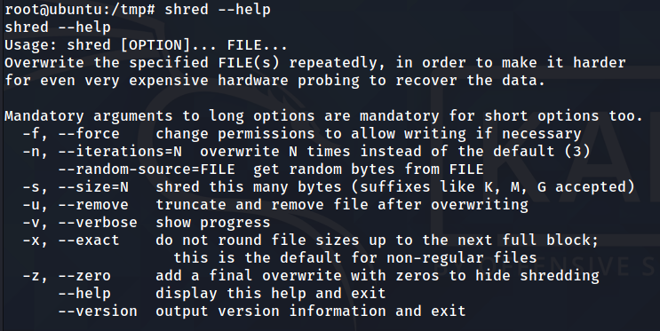
Shredding Logs
We can use the shred utility to wipe any traces of logs from the disk so as to cover our tracks. The options are specified below.

Slide 52
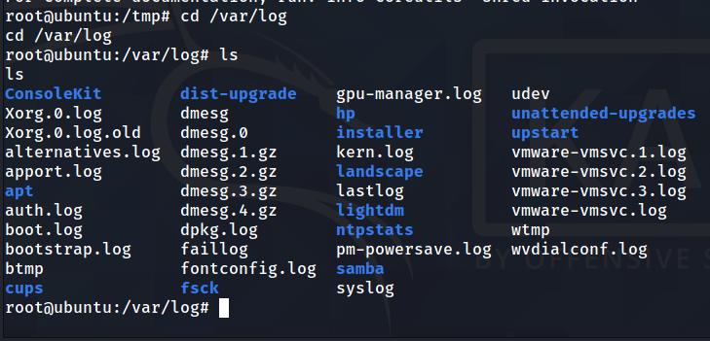
Shredding Logs
We will remove auth.log, which stores login information, syslog - which contains information about of connections to the system and kern.log which contains kernel processes.

Slide 53
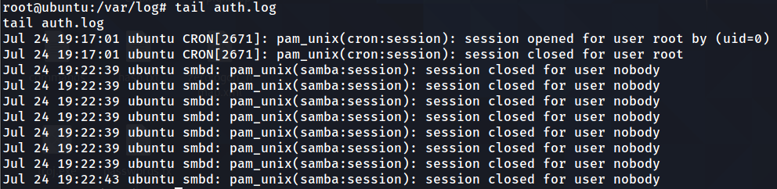
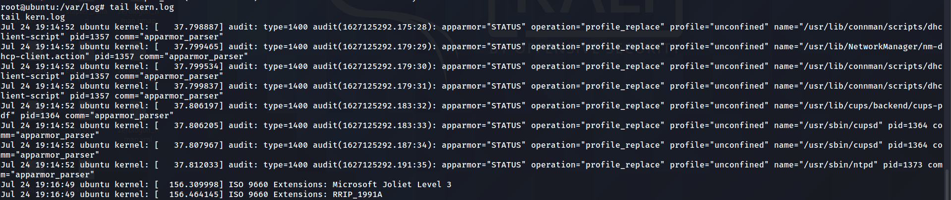
Shredding Logs
We will first concatenate them to verify that they are populated, specifically the end to show that our activities have been registered..

Slide 54
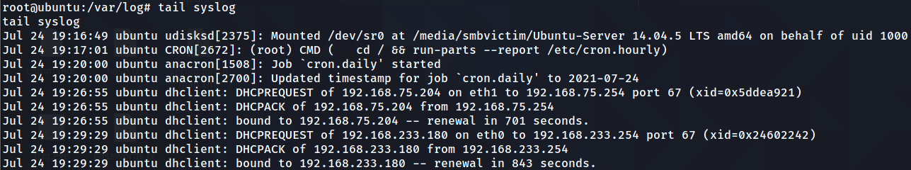
Shredding Logs
We will first concatenate them to verify that they are populated, specifically the end to show that our activities have been registered..

Slide 55
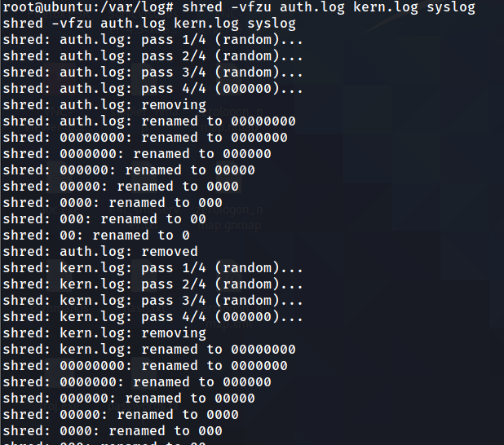
Shredding Logs
We can use the shred utility to wipe any traces of logs from the disk so as to cover our tracks
$ shred -vfzu auth.log kern.log syslog
-v : verbose info on progress
-f : force completion
-z : overwrite any existing data with zeroes (cannot discover using forensic tools)
-u : truncate and remove the file

Slide 56
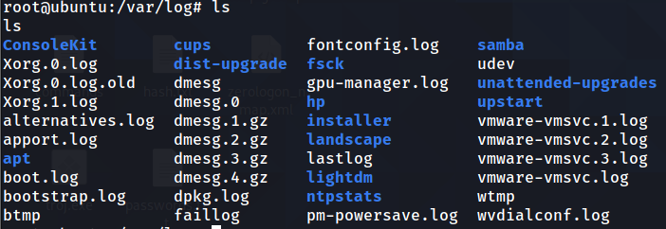
Shredding Logs
To verify that they have been removed successfully, we can do a listing.

Slide 57
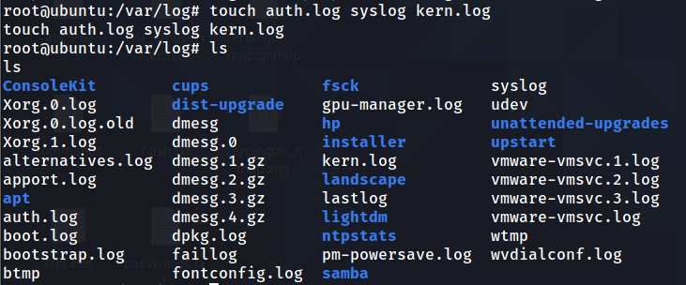
Shredding Logs
Thereafter we can name empty files after the original filenames to avoid suspicion from the SOC or network team (at least for the time being) that might be looking into the log
$ touch auth.log syslog kern.log

Slide 58
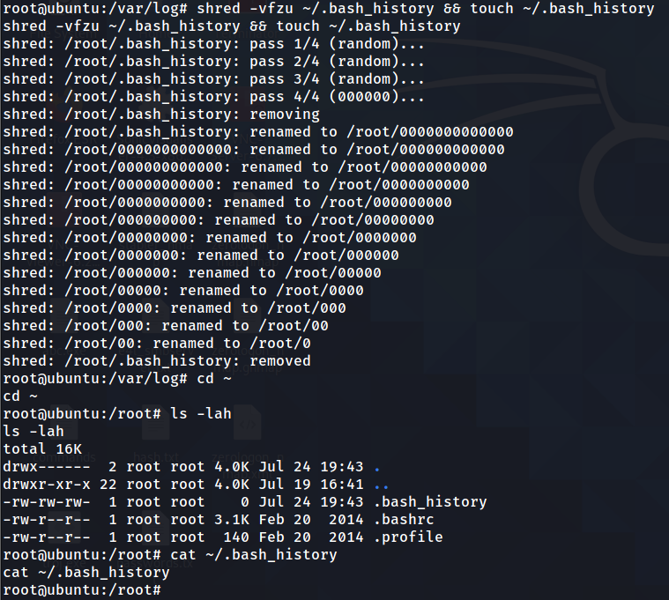

Shredding Logs
One last important file we have to delete is the bash history. We will follow a similar methodology as mentioned previously.

Slide 59

Pivoting
The next task to carry out on the machine is carry out reconnaissance of any other networks that the compromised machined maybe connected to (in this case eth1)
We can first do an ifconfig to get an idea of the interfaces available to be exploited.

Slide 60

Pivoting
We can then use sshuttle to route traffic through the compromised machine
We will need to supply kali’s password and the smbvictim’s password.
In this case the password for local sudo will be “kali” and smbvictim will be “smbvictim” as cracked previously using john the ripper.
Notes:
sshuttle -r smbvictim@25.12.156.134 192.168.75.0/24

Slide 61

Pivoting
To test if we have connectivity to the subnet, we can use fping and pipe the output to grep the string “alive”, which indicates that the host is active on the network. 192.168.75.1 is the default gateway and 192.168.75.204 is the eth1 interface of the ubuntu machine so only 192.168.75.192 requires further investigation which we will be conducting next. fping allows us to quickly and easily scan a network (or subnet) for active machines and requires a shorter amount of time compared to other scanning tools like nmap.

Slide 62
06. Exploiting ZeroLogon
Part 2: Zerologon (CVE-2020-1472)

Slide 63

Enumeration
Since we encountered a new host, we can first use nmap to scan the services in the subnet and on the specific machine we pinpointed, but unfortunately there is some issue scanning the ports (may be a nmap software issue as mentioned here).
Notes:
https://stackoverflow.com/questions/29902700/os-detection-using-nmap-for-a-particular-ip-address

Slide 64

Enumeration
We can then use the NSE script for os host discovery to check the open ports. Since Zerologon uses ports 135 and 445 which are open, we can attempt to exploit the vulnerability.

Slide 65

Find Windows Server Device Name
In Metasploit, use auxiliary/scanner/netbios/nbname, and set the rhosts as the IP address of the Windows Server.
This is to retrieve the device name of the Windows Server, in order for us to proceed with the ZeroLogon exploit.
Copy the name of the Windows Server in the output after running the auxiliary.

Slide 66

Metasploit ZeroLogon

Slide 67

Metasploit ZeroLogon
In Metasploit, use zerologon, and set rhosts as the IP address of windows server, nbname as the name of the Windows Server machine, and run.
You can enter check, to check if the target server is vulnerable.
The output will show that the machine’s password is set to an empty string.

Slide 68
Reasons for using Impacket Suite
allows for low-level access to network protocols and supports SMBv1 and TCP/IP, which we will use for attacking the windows machine.
free and open source
various utilities for different purposes (i.e. getting an interactive/semi-interactive shell) or dumping passwords etc.
useful after ZeroLogon has been completed since the password is now fixed (16 bytes of zeroes) and we can use the utilities to attempt to get remote shell access to the Windows server.

Slide 69

Impacket Secretsdump.py
Next, we will use Impacket’s secretdump.py to retrieve the password hashes of all devices in the Windows Server’s domain. Now that the Windows Server’s password is an empty string, we can set the parameter -no-pass.
We will use the Administrator’s password hash to gain access into the Windows Server.
Ensure that the exact path is specified when using secretsdump.py.

Slide 70


Impacket Psexec.py
In the same directory as secretsdump.py, use psexec.py with the parameters -hashes followed by the hash found from secretsdump.py, and specify Administrator and the target IP address.
A command shell from the Windows Server will be opened after running psexec.py, where we can execute any valid shell commands we wish to.

Slide 71

07. Windows Server Post-Exploits

Slide 72

Turning Off Windows Firewall
In the active Windows command shell session on Kali Linux, enter netsh advfirewall show allprofiles to view the states of all firewall settings.
The image shows the domain profile firewall is still in ON state.

Slide 73


Turning Off Windows Firewall
After running the command netsh advfirewall set allprofiles state off, an Ok is shown in the output.
Running show allprofiles again shows that all Windows firewall states are OFF.

Slide 74


Turning Off Windows Firewall
Checking the firewall settings on the Windows machine shows that the Windows Defender Firewall states are OFF.
Turning off the Windows Defender Firewall reduces the security measures in the Windows machine, because it removes its ability to monitor and prevent malicious network traffic from attackers. This makes it easier for hackers to attack it through various means.
The video is a demonstration of turning off the Windows Defender Firewall with an active Windows shell session.

Slide 75


Denying Access to Important Files
In the Windows Server, a folder is created to simulate an important folder.
In the active Windows command shell session in Kali Linux, the important folder can be seen using the dir command in the Documents directory.

Slide 76


Denying Access to Important Files
Using the command cacls “[path directory of important folder]” /P everyone:N and entering “y” after that to confirm, all users are denied any access to the important folder.
The image shows two errors when clicking on the important folder after the command is ran, even though administrative rights is given. This is because the permissions are denied.

Slide 77

Denying Access to Important Files
This can be done on actual important files such as logs and data, which can affect victims and businesses from their work process.
The video is a demonstration of denying access to files with an active Windows shell session.

Slide 78
08. References and Additional Troubleshooting

Slide 79



Methods in Obtaining Vulnerable Samba Version
Compiling from source
(FAILED since dependencies are missing)
Installing using jessie deb packages
(NOT FEASIBLE since too many dependencies to download)
Downloading Ubuntu 16.04
(FAILED to be exploited -- refer to next few slides)

Slide 80

Why Ubuntu 16.04 didn’t work
We first experimented with version 16.04 as we thought that it being in the range of the vulnerable versions, the Debian Free Software Guidelines versioning was already patched for these series of OSes

Slide 81


Why Ubuntu 16.04 didn’t work
Although the versioning was generally vulnerable as detected using nmap, it wasn’t susceptible since it already had been patched. We can verify this by using the “apt-check-versions” package. We found this in the README file on the exploit.
Notes:
https://github.com/rapid7/metasploit-framework/blob/master/documentation/modules/exploit/linux/samba/is_known_pipename.md

Slide 82
References
https://wiki.samba.org/index.php/Build_Samba_from_Source
https://packages.debian.org/jessie/samba
http://releases.ubuntu.com/16.04/
https://old-releases.ubuntu.com/releases/14.04.5/​
https://www.youtube.com/watch?v=lGr7VUCBvOQ
https://github.com/rapid7/metasploit-framework/blob/master/documentation/modules/exploit/linux/samba/is_known_pipename.md
https://github.com/sshuttle/sshuttle
https://linuxize.com/post/etc-shadow-file/

Slide 83
References
https://github.com/SecureAuthCorp/impacket
https://www.youtube.com/watch?v=GNnt6ZB2x5k
https://5h4d0wb0y.github.io/2017-06-25-stapler/ (writeup, got idea for using python to create bash shell)
https://medium.com/@lucideus/sambacry-rce-exploit-lucideus-research-3a3e5bd9e17c
https://itsfoss.com/ppa-guide/ (sources.list and other versioning issues on old ubuntu systems)
https://nmap.org/nsedoc/scripts/smb-vuln-cve-2017-7494.html

Slide 84
THANKS!
Youtube Link for 2 Exploits and Linux Post Exploits https://www.youtube.com/watch?v=c5OLZ9g48io
iVid2 Link for 2 Exploits and Linux Post Exploits https://ivid2.np.edu.sg/media/EH+Assignment+%28SambaCry+%26+ZeroLogOn%29/1_wv17pm1e
Youtube Link for Windows Post Exploits
https://www.youtube.com/watch?v=AfYuxOHCXHw
https://www.youtube.com/watch?v=4QXvn5q-zNA
iVid2 Link for Windows Server Post Exploits
https://ivid2.np.edu.sg/media/EH%20Assignment%20Denying%20File%20Access%20Post%20Exploit/1_pqvpvqdb
https://ivid2.np.edu.sg/media/EH%20Assignment%20Disabling%20Firewall%20Post%20Exploit/1_gpzufzhg

